Slide 1

1. Home Page
<Game Name>
Username:
Password:
Forgot password
Login

Slide 2


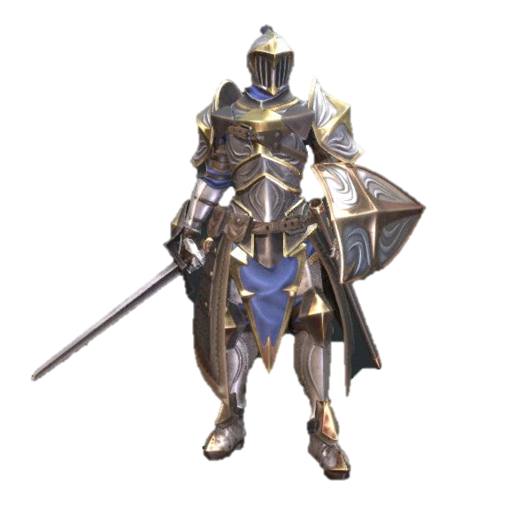


Go to Settings (4)
2. Character Selection (Unlocked)
Username
LV 2
35 / 100
Knight
Abilities
Get 10% more hp at the start of each battle.
Tap to cycle through characters
Knight
Select
Character
Select the character and go to Main Page (5)
Change Character | Statistics | Leaderboard | Assignment | PVP

Slide 3

3. Character Selection (Locked)
Username
LV 2
35 / 100
Mage
Abilities
Gain 10% bonus points
Mage
Select
Character
Selection box greyed out when character is not unlocked
Change Character | Statistics | Leaderboard | Assignment | PVP

Slide 4

4. Settings
John Tan (ID:12345)
Username
Change Username
Email@e.ntu.edu.sg
Change Email
Change Password
Logout
BGM

Slide 5

5. Main Page
Username
LV 2
35 / 100
Requirement Engineering
Tap on image to enter world.
Go to Stages (6)
Subject description will be written here.
Tap to cycle through worlds
1. Requirement Engineering
Stages Cleared: 1/3
Change Character | Statistics | Leaderboard | Assignment | PVP
Go to Character Selection (2)

Slide 6


6. Stages
Username
LV 2
35 / 100
1-1
1-2
Topic
Requirement
Elicitation
1-3
Medium
Topic
GO
Tap to choose difficulty. (Easy, medium, hard)
Tap to enter battle.
Go to Battle (7)

Slide 7


Current question out of total questions
Total points accumulated
Time left in battle
7. Battle
60
3:00
3/10
80 / 100
Question
1. Answer
2. Answer
3. Answer
4. Answer
Box turns green when right answer is selected. Turns red when wrong answer is selected.
Abilities that can be used in battle

Slide 8



8. Stage cleared
Stage Cleared
1-2 Medium
830
Highest record: 1000
Share
Retry
Exit
Next Stage
Go back to Main Page (5)

